Slide 1
Smart Home Energy Management System
Group 31

Slide 2
Name | Student ID
Ankita Shinde | 40230690
Purvesh Sakhiya | 40221354
Yash Bhavsar | 40219504
Ishan Pansuriya | 40232841
Github : SPM_Project_Group_31

Slide 3
Agenda
Problem Statement
Market Analysis
Feasibility Study
Software Solution Proposal
Software Solution Project Plan
Risk Assessment
Software Budgeting

Slide 4
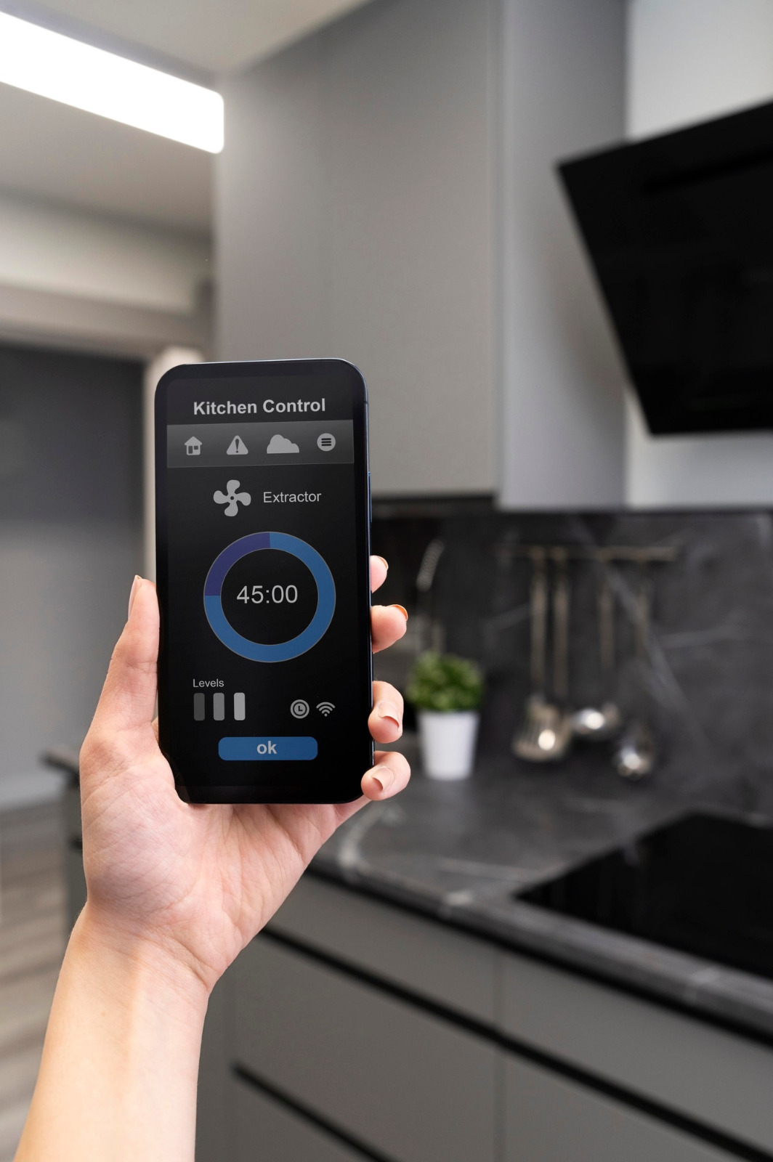
Problem Statement
Current Issue:
Homes face energy inefficiency due to unoptimized appliance use and lack of smart Integration.
Impacts:
High utility costs for homeowners.
Increased environmental footprint
Needs:
Smart integration for better appliance coordination.
User-friendly interfaces for insightful energy management.
Scalable solutions adaptable to various home environments.
Strong security to protect user data.

Slide 5

Market Analysis
Target Audience:
Urban and suburban homeowners, 25-65, tech-savvy and environmentally aware.
Key Players:
Panasonic, Honeywell, IBM, Robert Bosch.
Growth Projection:
Market expected to reach USD 9.41 billion by 2029 (CAGR of 15.23%).
Challenges:
Ensuring compatibility with diverse home setups.
Maintaining user engagement and satisfaction.
Opportunities:
Leveraging IoT for enhanced system responsiveness.
Expanding market reach through interoperability improvements.

Slide 6

Feasibility Study
Hardware & Software: Identify required components and software platforms.
Integration & Compatibility: Assess compatibility and integration with existing systems.
Scalability & Performance: Analyze scalability and conduct performance testing.
Economic Feasibility: Evaluate costs, savings, and ROI.
Operational Feasibility: Gauge user acceptance and provide support.
Legal & Regulatory: Ensure compliance and implement security measures.

Slide 7

Solution Proposal

Slide 8
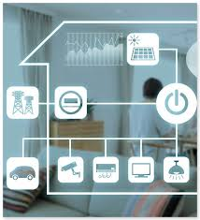
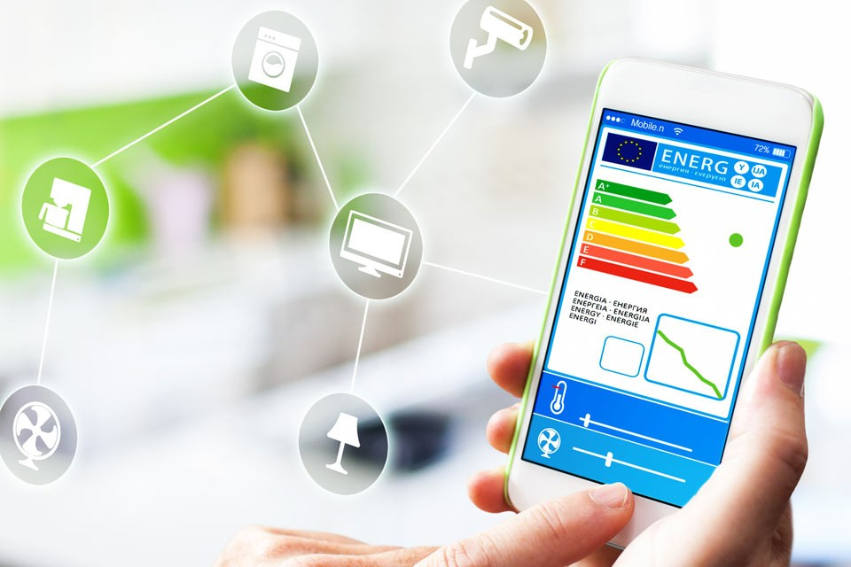
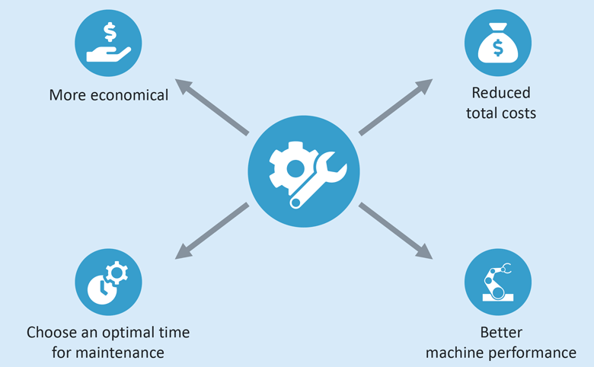
Energy Monitoring & Analysis:
ML for load forecasting and anomaly detection.
Real-time processing for insights.
Intelligent Energy Optimization:
Adaptive scheduling for load shifting.
Personalized strategies.
Predictive Maintenance:
ML-based fault detection.
Root cause analysis.
Energy Monitoring & Analysis
Intelligent Energy Optimization
Predictive Maintenance

Slide 9
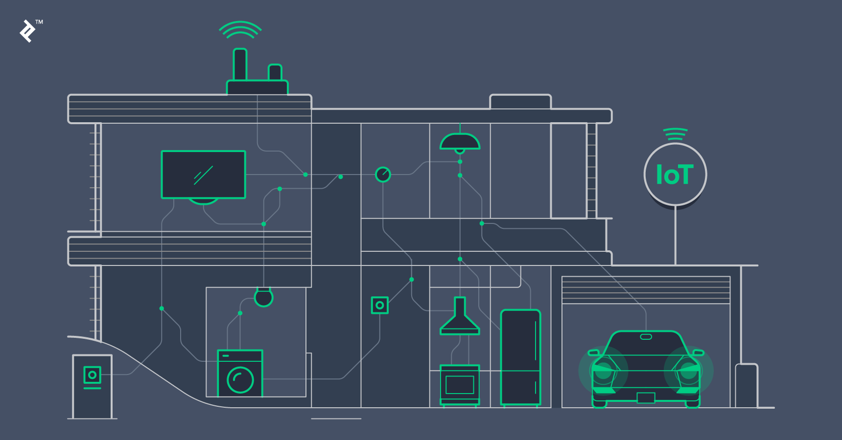
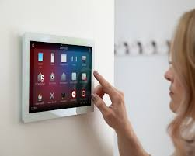

Energy Trading & Demand Response:
Blockchain for secure trading.
Real-time response to pricing signals.
Enhanced User Interfaces:
Intuitive interfaces with dashboards.
Gamification for engagement.
Continuous Improvement:
Feedback for usability.
Analytics for security/performance.
Energy Trading & Demand Response
Enhanced User Interfaces
Continuous Improvement

Slide 10
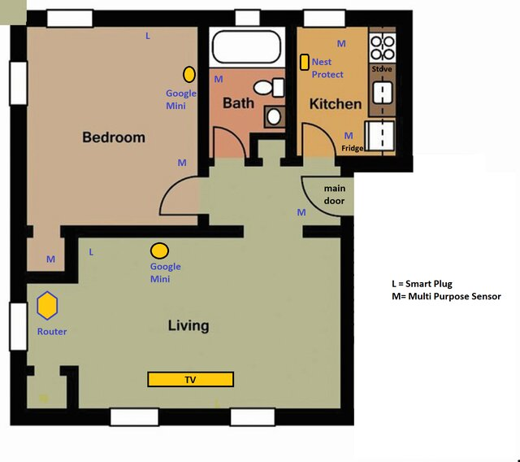

Slide 11
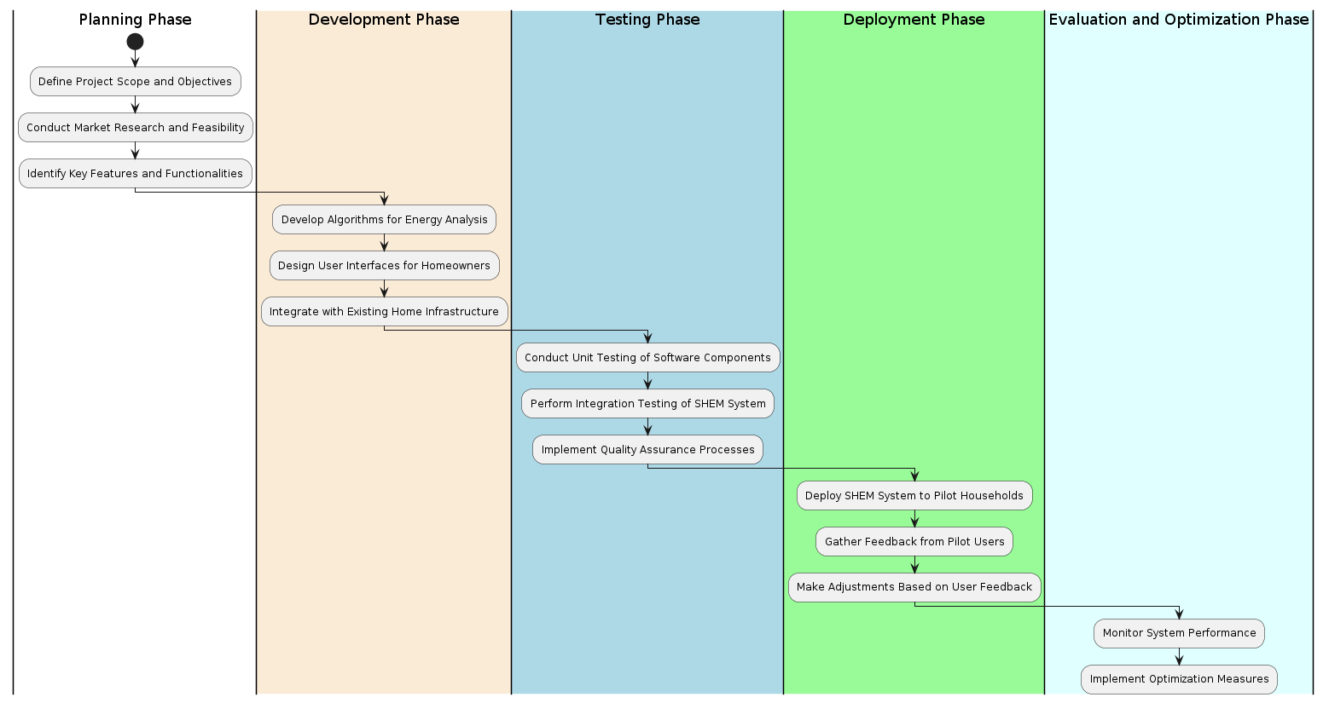
Software Solution Planning Phase

Slide 12
Risk Assessment
Cybersecurity Risks:
Vulnerabilities in networked devices.
Threats of hacking and data breaches.
Need for robust encryption and security measures.
Privacy Concerns:
Collection and transmission of sensitive user data.
Risks of misuse or unauthorized access.
Importance of strong data protection measures.
Stability and Dependability:
Risks of system failures and malfunctions.
Potential interruptions to household operations.
Importance of ensuring continuous energy management.
Interoperability Challenges:
Issues with merging different smart devices.
Risks of compatibility problems and inefficiencies.
Need for seamless integration and communication.
Physical Security Threats:
Risks of tampering or illegal access.
Importance of protecting system integrity.
Ensuring home safety and security.
Data Ownership and Rights:
Concerns about third-party access to user data.
Need for transparency and accountability.
Safeguarding user privacy and rights.

Slide 13
How To Overcome Risk Assessment
Prioritize Cybersecurity Measures:
Implement robust encryption protocols and regular software updates.
Enforce strict access controls and authentication mechanisms to prevent unauthorized access.
Ensure System Reliability and Stability:
Proactively manage and test the SHEMS to address malfunctions or vulnerabilities.
Promote Interoperability and Compatibility:
Establish interoperability standards and conduct compatibility testing among smart devices.
Integrate technologies seamlessly to mitigate interoperability issues.
Enhance Physical Security Measures:
Implement measures to prevent tampering and unauthorized access to smart devices.
Continuous Monitoring and Improvement:
Regularly monitor the performance and security of the SHEMS.
Stay updated on emerging threats and technologies to adjust security measures.

Slide 14
Thank you!

